Slide 1


Accessibility Resource Center
March 9, 2023
Understand
Test
Solve
COLOR CONTRAST

Slide 2

Aaron Farber
2016: Change careers from public policy to tech. Attend App Academy.
2017-2019: Run accessibility testing/development shop focused on small businesses
2019-2020: TPGi - Accessibility Engineer
2021: TPGi - Embedded with large tech company
2022: TPGi – Accessibility Platform Consultant
Notes:
2019: Web Accessibility Specialist
2020: Certified Professional in Accessibility Core Competencies
IAAP: International Association of Accessibility Professionals

Slide 3
Learning Objectives:
1
Plan for Accessibility Testing
2
Keyboard Focus Styling
3
Text Color Contrast
4
Non-Text Color Contrast

Slide 4
Empowerment Program
Create a repeatable, well-defined accessibility testing process.

Slide 5
Empowerment Program
Empower teams to address issues one by one while growing their understanding of accessibility over time.

Slide 6
Empowerment Program
Lack of accessibility buy-in not due to a lack of will or skill. It’s due to a lack of clear steps.

Slide 7
Each month, starting today, TPGi will hold a webinar covering one group of accessibility guidelines
30 Minute Presentation – 30 Minute Q&A

Slide 8
1
Plan For Accessibility Testing
Create A Test Plan
Divide your application into a set of representative samples

Slide 9

Before Monitoring, Plan for Testing

Slide 10
Break site into components

Slide 11
Group Related Accessibility Guidelines
Enables testing to be done by roles with the requisite skillset
Increases efficiency and reduces duplicative work, shifting between unrelated accessibility guidelines
Leads to full WCAG Coverage

Slide 12
Color Contrast Testing
- Does not require a engineering background to test.
- Requires only basic familiarity with Developer Tools

Slide 13
Color Contrast Testing
1.4.3: Color Contrast (AA)
1.4.11: Non-text Contrast (AA)
2.4.7: Focus Visible (AA)
1.4.5: Images of Text (AA)– partially covered
1.4.1: Use of Color (A) – partially covered

Slide 14
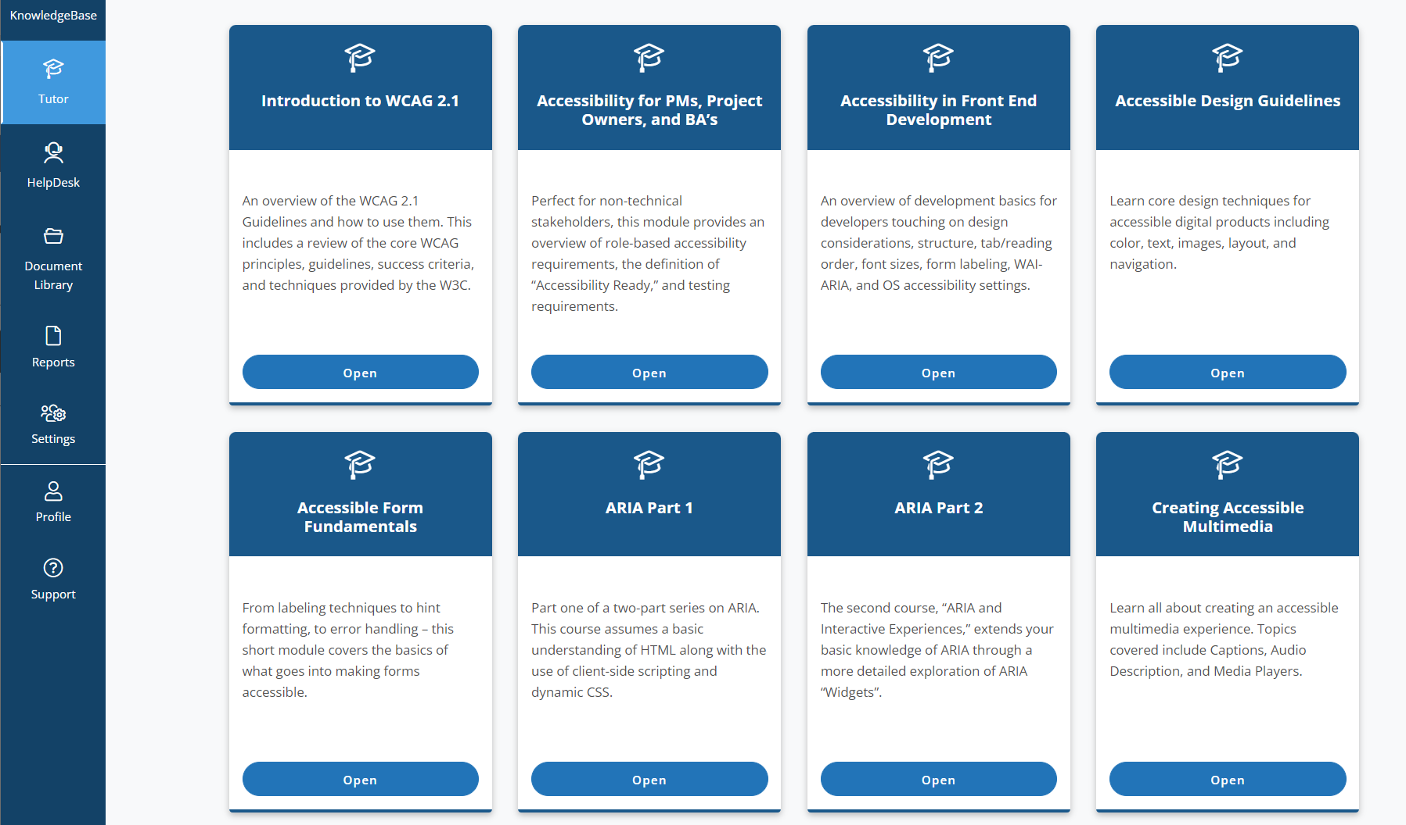
Accessibility Foundations
For Keyboard Testing: Accessibility for Product Owners, PM, and BA’s is recommended
Consume Role-Based Trainings To Understand Fundamental Principles

Slide 15
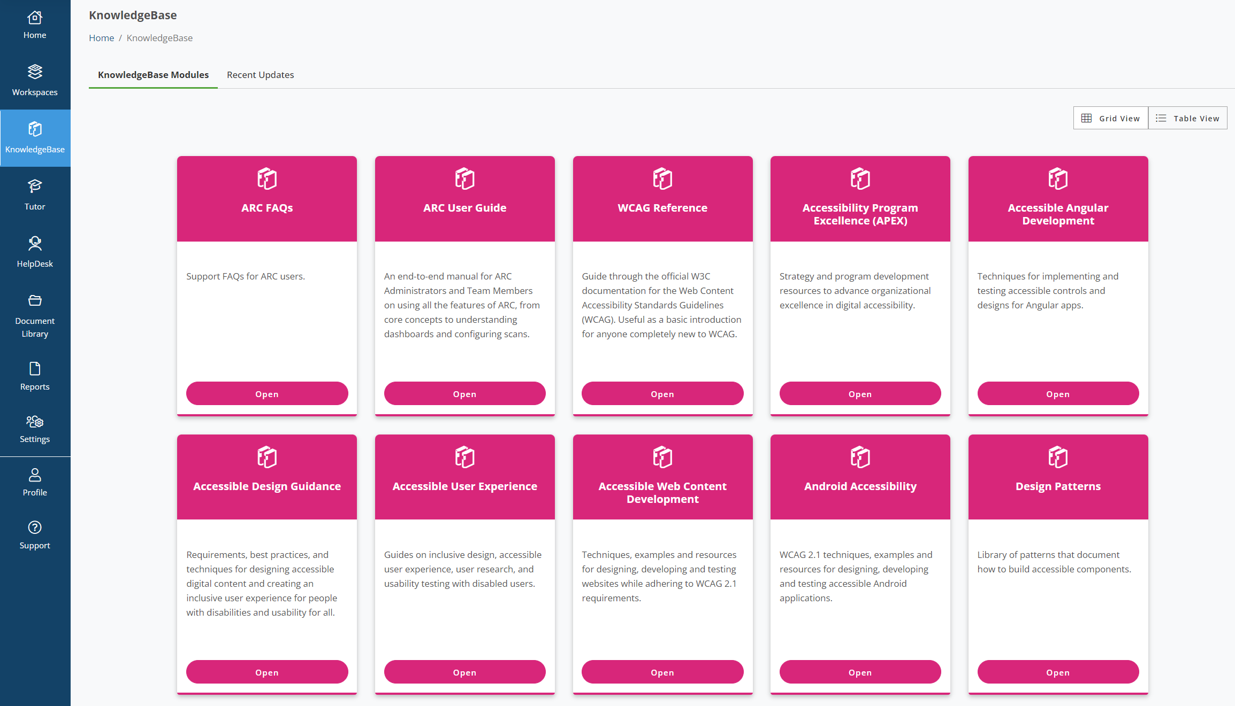
Tools and Resources
ARC’s KnowledgeBase Is Your Single Greatest Resource

Slide 16
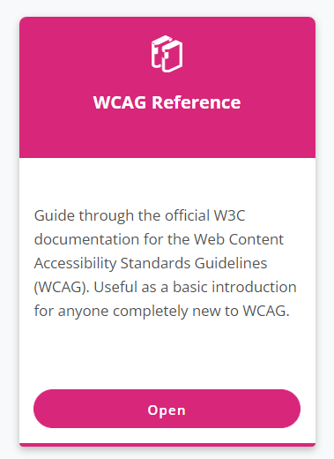
Understand
Understand The Significance of an Accessibility Guideline First
Summarizes Each Accessibility Guideline

Slide 17
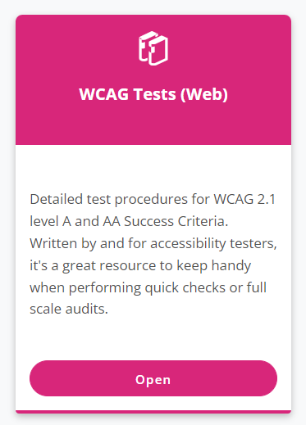
Test
Test An Issue To Determines Its Impact On User Experience
Provides Step-by-Step Manual Testing Procedure for Every Accessibility Guideline

Slide 18
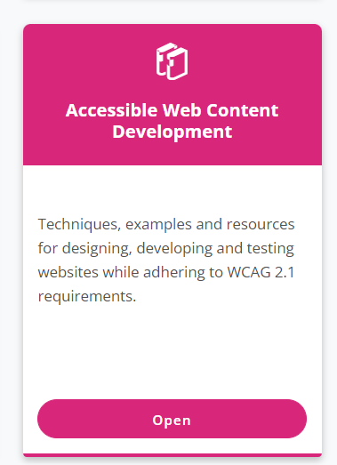
Solve
Solve an Issue with Battle-Tested, Clear Steps For Implementation
Code Samples, Expected Behaviors, Allows You to Retest and Validate the Solution

Slide 19


Equip your team with testing tools
Colour Contrast
Analyzer
ARC Toolkit

Slide 20
Colour Contrast Analyzer
Enter color values or use its eye-dropper tool
Works at the operating system level so grab any two pixels on the screen, not just within the browser

Slide 21
Color Contrast Text Requirements
Text and images of text must have a contrast ratio of at least 4.5:1
Large text (over 18 point or 14 point bold) has a contrast ratio of at least 3:1
WHY? Text that is larger and has wider character strokes is easier to read at lower contrast.

Slide 22
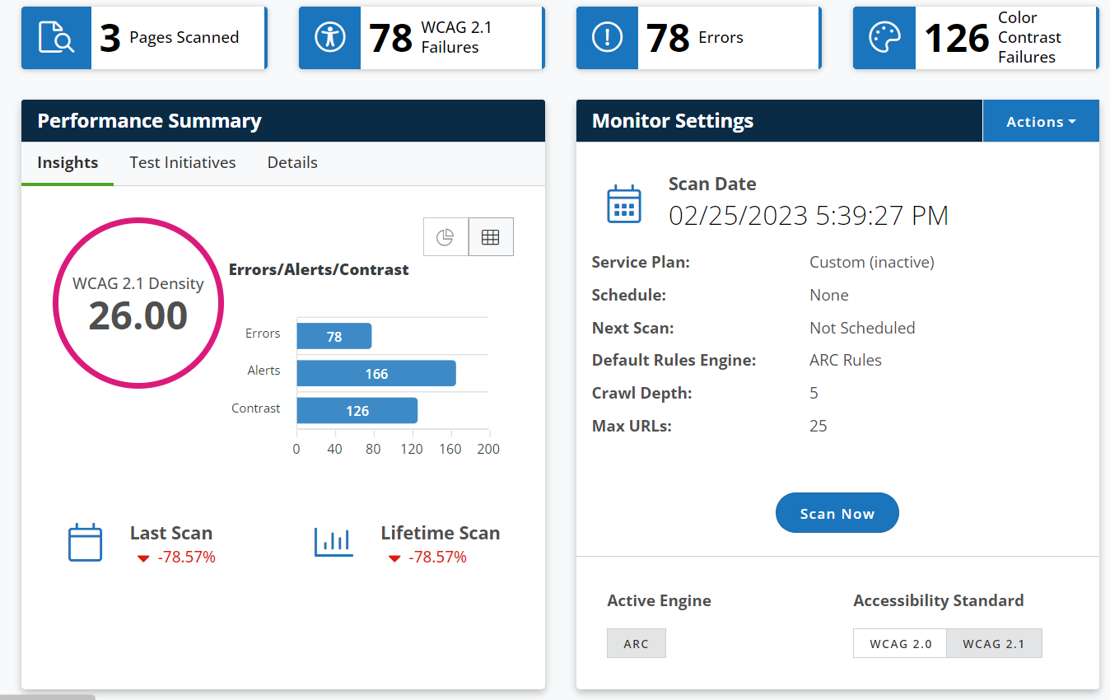
ARC Monitoring
Displays number of color contrast errors
Rather than the individual errors

Slide 23
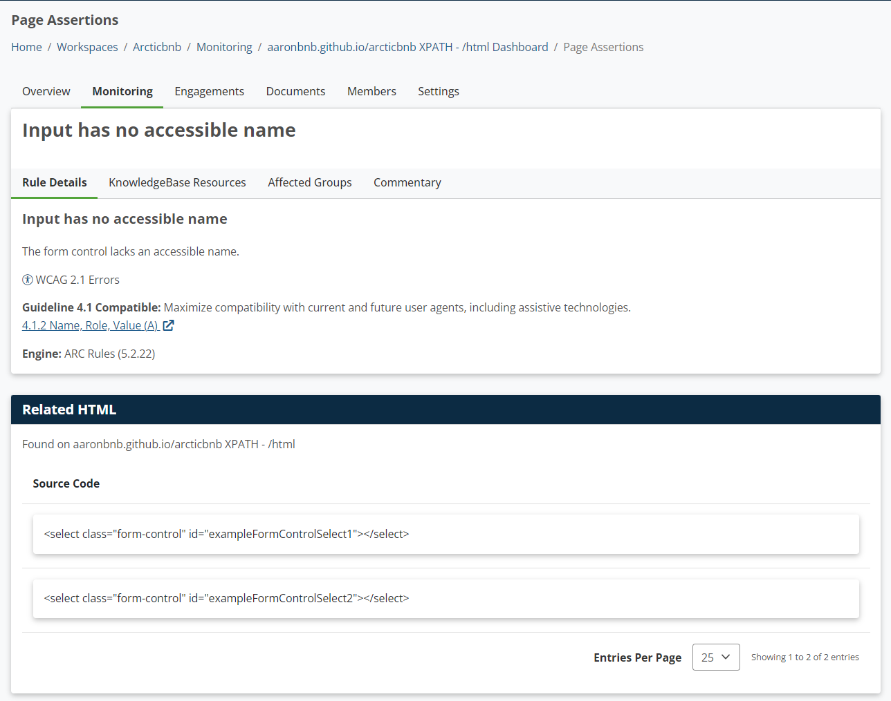
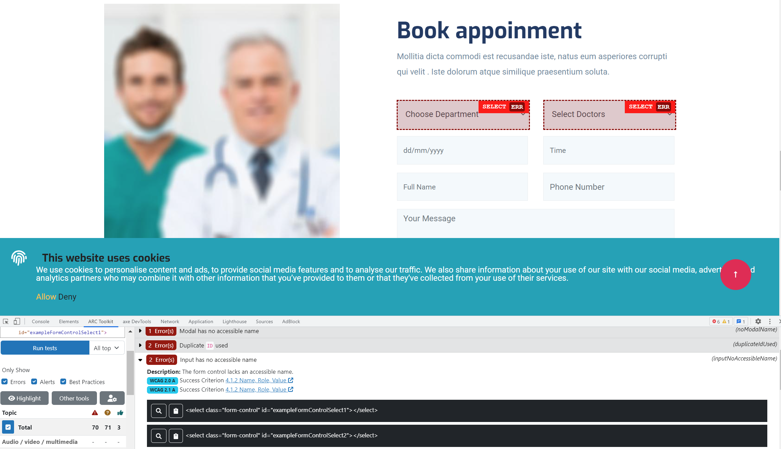
ARC Toolkit – its role in relation to ARC Monitoring
ARC Monitoring Display Test Results as HTML code snippet with access to ARC tools/resources
ARC Toolkit > Select Run Tests
Flags the element on the page
Visually inspect the element
Same issue

Slide 24

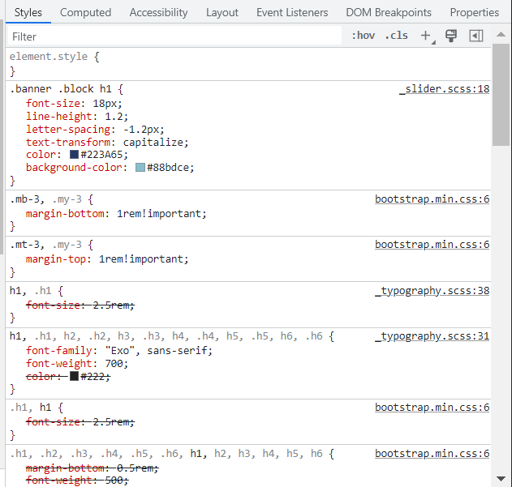
Text Color Contrast
Best Practice:
Compare the explicit author defined CSS color values
the hexadecimal codes

Slide 25
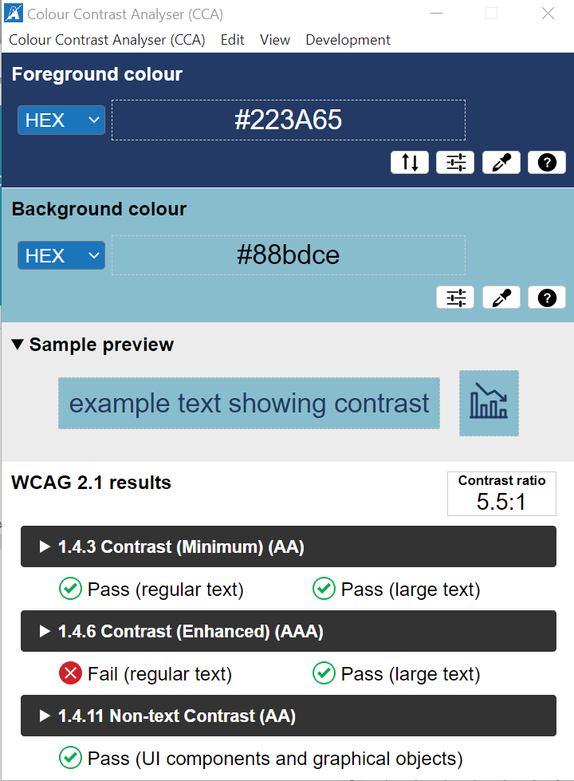
Text Color Contrast
Enter the hexadecimal codes into Colour Contrast Analyzer
Provides color contrast ratio
Indicates WCAG requirements based on text size

Slide 26
Exceptions to text color contrast requirements
Disabled interactive controls
Branding

Slide 27
Eye Dropper Tool
Monitor calibration profiles affect the color value drawn by an eye dropper tool
Therefore, an element could pass on one device and fail on another
Best Practice is to be device-agnostic

Slide 28
Eye Dropper Tool
Use for images of text, charts, graphics – all that content that doesn’t have a defined CSS value

Slide 29
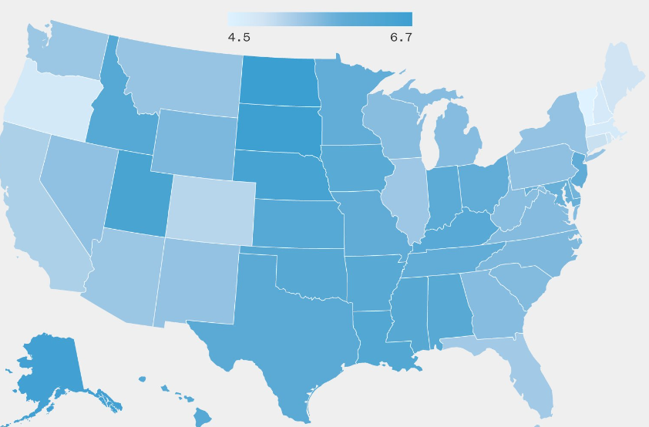
Non-Text Color Contrast
UI Components
Graphical objects
Parts of graphics required to understand the content

Slide 30
Solving Non-Text Color Contrast
Use
Patterns
Data Labels
More Distinct Colors

